Slide 1
Backup Exec Reports Using Azure Power BI
Riya Mate

Slide 2
Agenda
1 | Overview
2 | Workflow
3 | Demo
4 | Future Ideas
5 | Q&A

Slide 3
Overview
Objectives
Making use of other Azure services
Ability to report from multiple Backup Exec media servers
Ability to share the reports with multiple users
Dashboard with drill-through functionality
Support for interactive features
Notes:
Cross-filtering removes data that doesn't apply. Selecting Moderation in the doughnut chart cross-filters the line chart. The line chart now only displays data points for the Moderation segment.
Cross-highlighting retains all the original data points but dims the portion that does not apply to your selection. Selecting Moderation in the doughnut chart cross-highlights the column chart. The column chart dims all the data that applies to the Convenience segment and highlights all the data that applies to the Moderation segment.
Other azure services such as data analytics

Slide 4
Overview
Azure Power BI Service
Azure CosmosDB
Arcus Service (Backup Exec)
Technologies

Slide 5




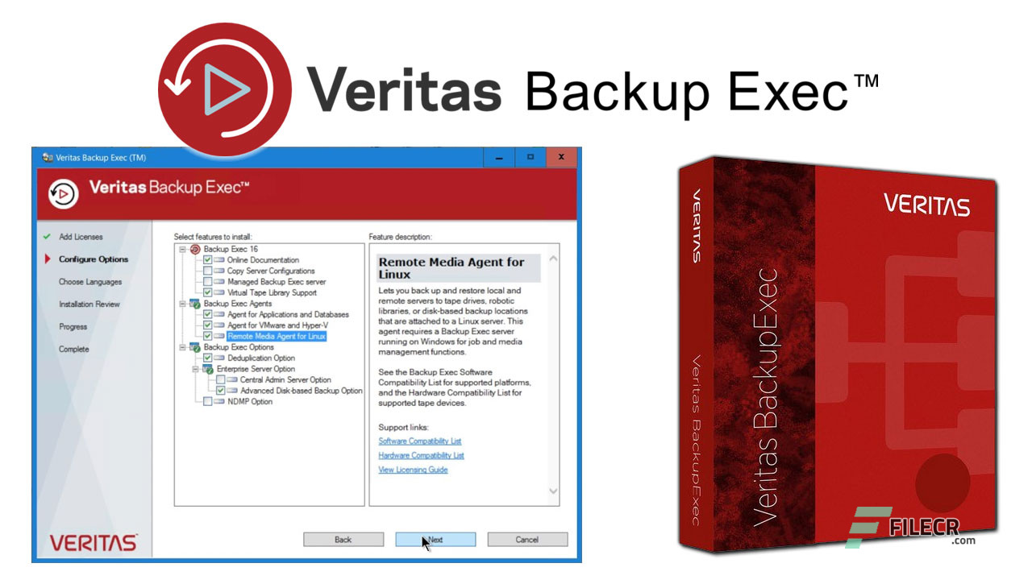
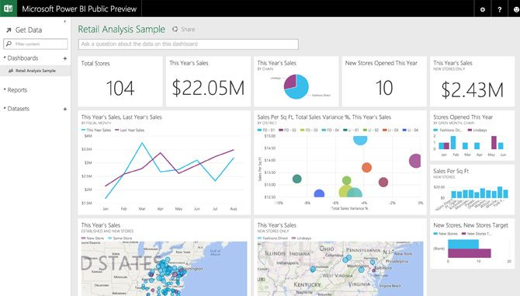
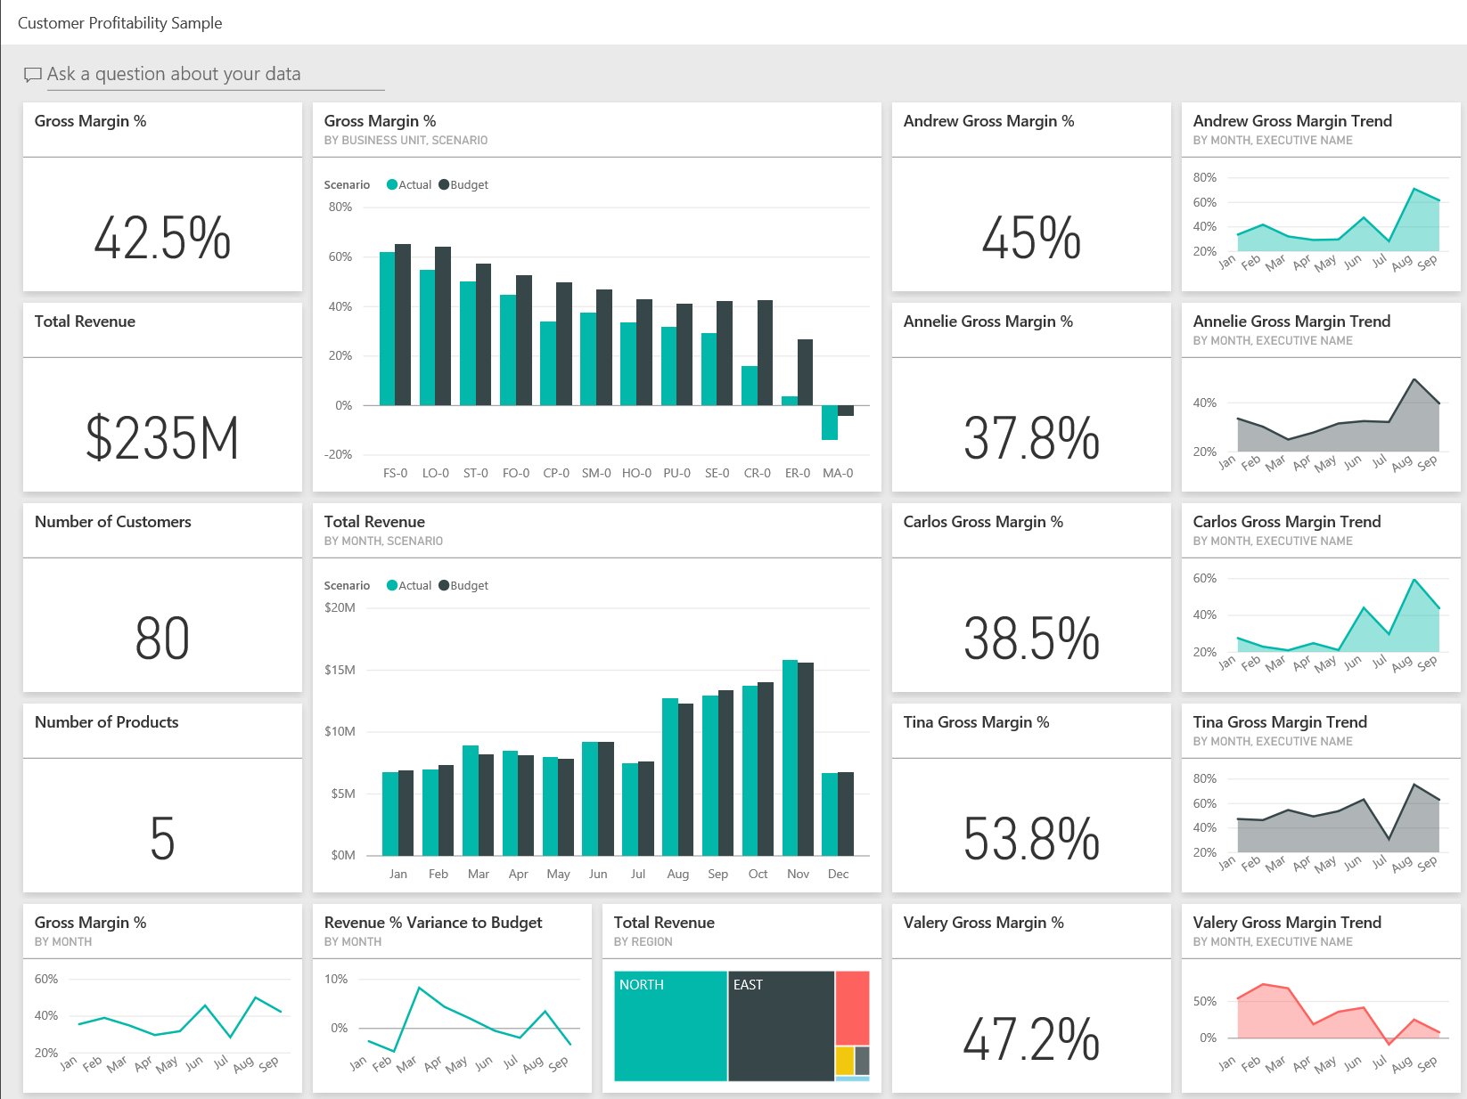
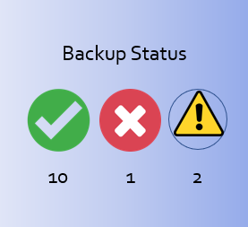
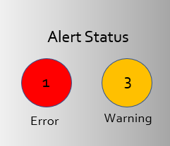
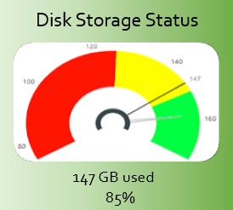




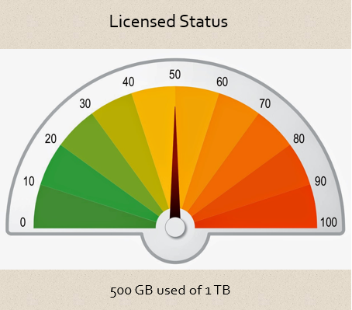
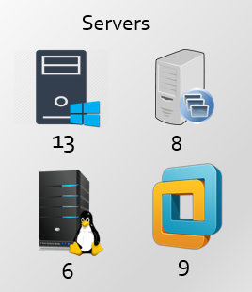


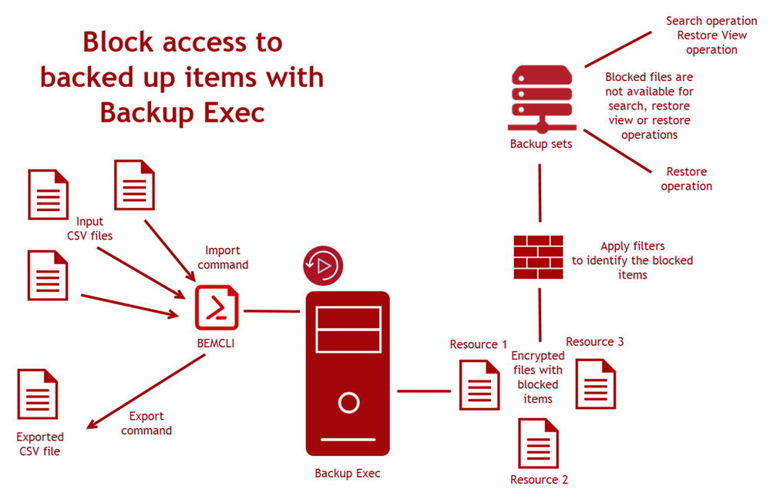






Customer’s Azure Subscription
BE PBI App
Power BI Service
Azure CosmosDB
2
3
Push Data
1
Report Viewers
1
2
…
Media Servers

Slide 6
Azure Power BI Service
Business intelligence and data visualization tool
Rich and interactive widgets
Cross-filtering and cross-highlighting features
Publishing and sharing features
Accessible using web UI and mobile application
Requires PBI-pro subscription for $9.99/month
Ability to leverage Azure services like data analytics
Deployable from app source into user’s Azure subscription

Slide 7
Arcus Service
To be installed on every BE media server
Collects data from BE media servers
Pushes the data to Azure CosmosDB
Data collection frequency is customizable
Veritas Backup Exec (BE) tool

Slide 8
Azure CosmosDB
Stores the data pushed by Arcus service
Pricing is based on throughput and storage
Fully Managed database service
Notes:
Show arcus demo in which cover service pane, configuration file (time frequency point)

Slide 9

Deployment
Workflow
9

Slide 10
Deployment Workflow
Install Arcus service on media server
Create CosmosDB in Azure account
Install and configure Arcus service with CosmosDB access details
Download BackupExec app from App source
Buy PBI pro license or use 2 months free subscription of license
Install and configure the app with CosmosDB access details

Slide 11
Screenshot
Configuration of BE App
Veritas BE Report
Azure CosmosDB URL
https://dbname.documents.azure.com:443/
Azure CosmosDB Account Key
YCPVtkM6t3EtZIEoYCPVtQM6t3EtZIEoyyas==
Next
Cancel

Slide 12
Report
Workflow
Copyright © 2020 Veritas Technologies, LLC.
12

Slide 13
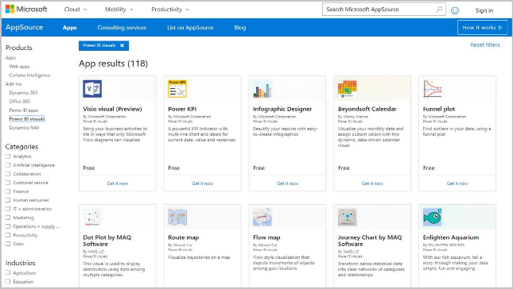
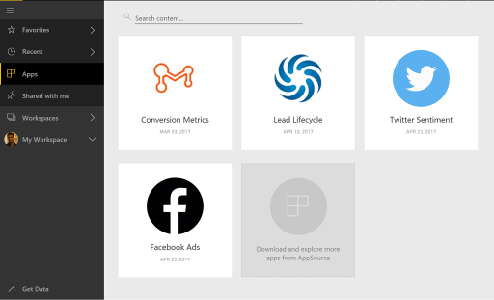

Power BI's App Source
Veritas Backup Exec Report
Veritas BE Report
By Veritas Technology LLC
Report includes different types of visual that gives many insights for the user.
Veritas BE Report

Slide 14
Future Ideas
Storage trending and forecasting
Job performance analysis
Any more thoughts/ideas?
Resource topology (CAS-MMS-Agents-Storages)
Remote error reporting, analysis & fix
Mobile App

